Slide 1

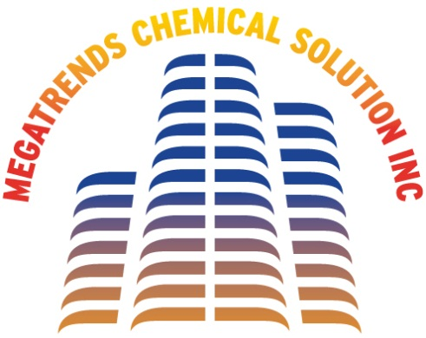







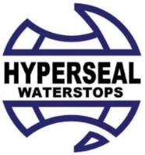







MCSI
MEGATRENDS CHEMICAL SOLUTION INC
COMPANY PROFILE
&
PRODUCTS

Slide 2




MCSI
MEGATRENDS CHEMICAL SOLUTION INC
Megatrends in brief:
Megatrends Chemical Solution Inc is in the field of importation and distribution of specialty construction chemicals such as General &
Structural Glazing, Waterproofing, Fireproofing and Construction adhesives & Joint sealant.
Our years of combined experience gives us confidence to served our valued customers and principals to represent global best brands from various manufacturer, countries like SOUTH KOREA, USA, GREECE, ITALY, SPAIN, TAIWAN and MALAYSIA…ETC
We have been accepted and embraced the new technology we have offered which we provided compelling solutions. Working with the biggest contractors and monumental projects in the Philippines, we were able to provide innovative solutions which was initially unusual, far different from conventional products and procedure they knew but they eventually

Slide 3
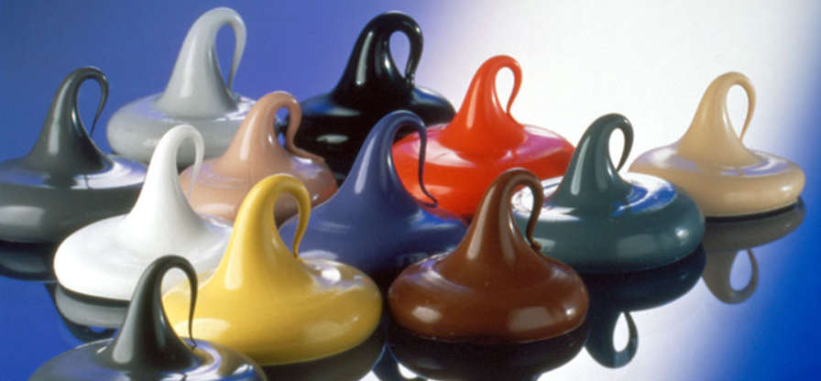
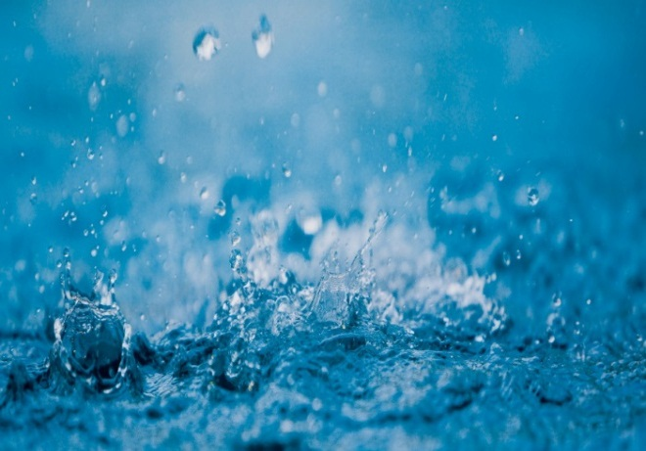
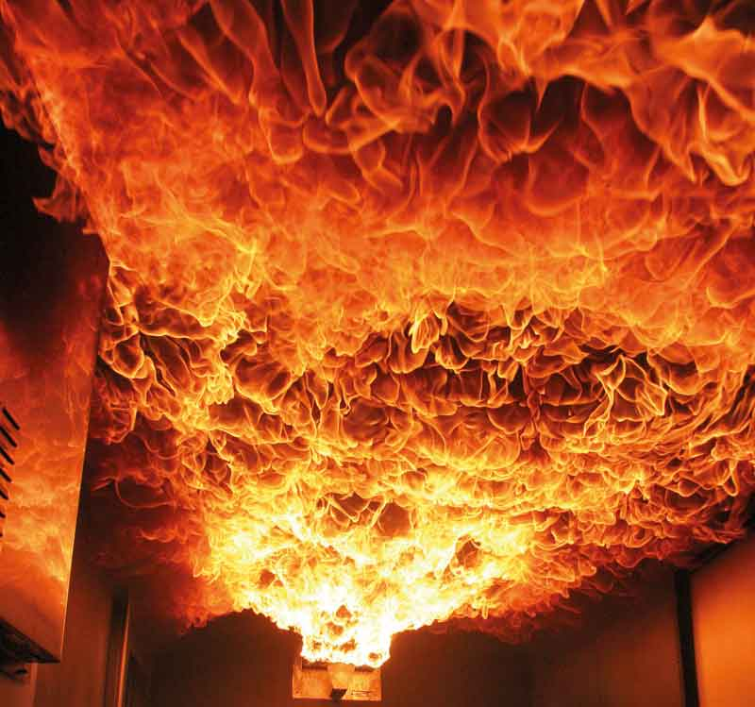
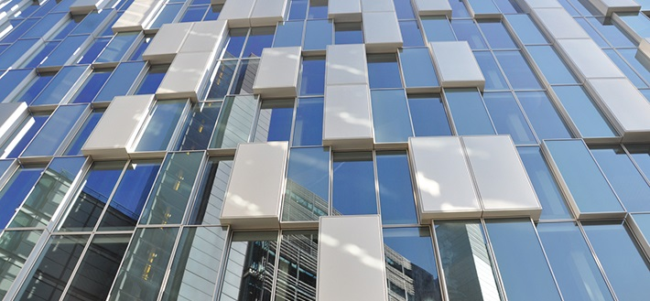



MCSI
MEGATRENDS CHEMICAL SOLUTION INC
Our solution :
Structural
&
General Glazing
Waterproofing
Solution
Construction Adhesive
&
Joint Sealants
Firestop Solution

Slide 4
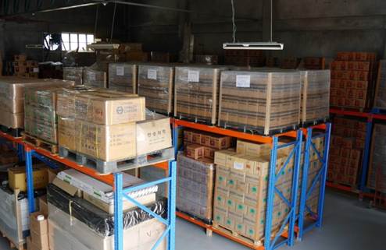
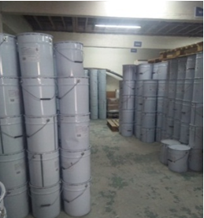
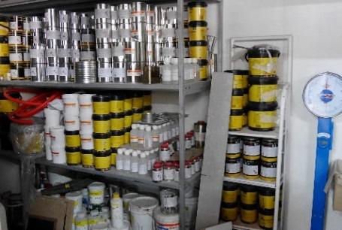
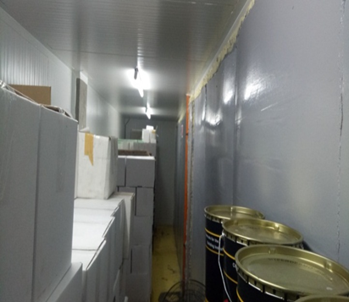
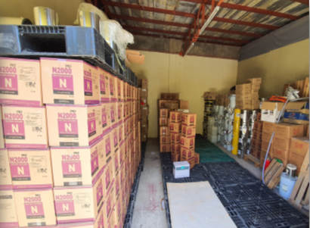
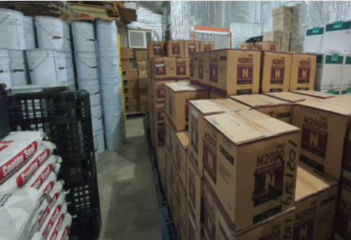
MCSI
MEGATRENDS CHEMICAL SOLUTION INC
Main warehouse – Manila
Laboratory & Air-conditioned Room– Manila
Branch Warehouse – Mandaue City / Cebu

Slide 5
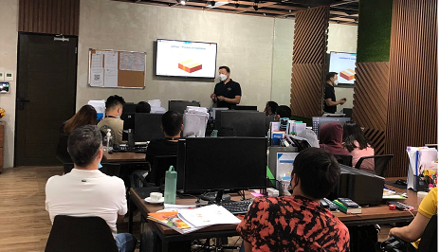
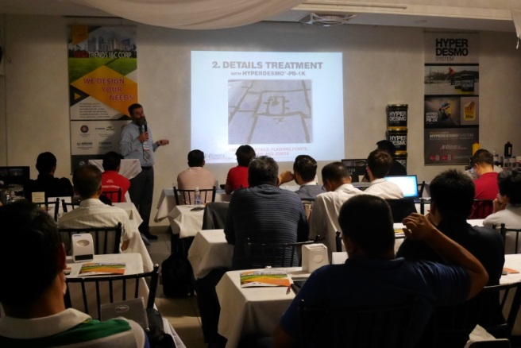
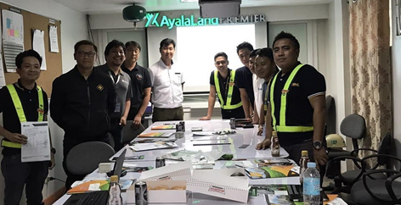
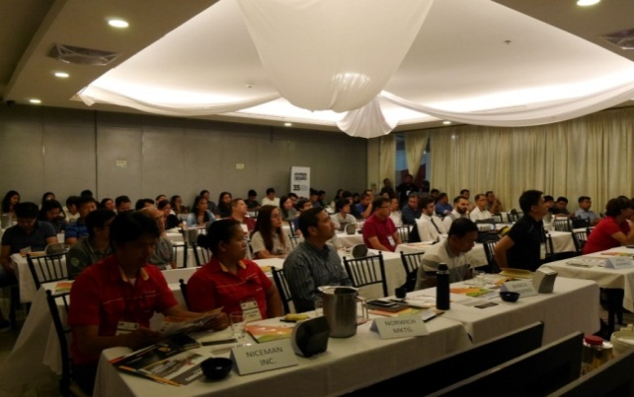
MCSI
MEGATRENDS CHEMICAL SOLUTION INC
Marketing Activities:
1. Product Seminars & Presentation
Nowadays, technology never stops. New materials are made to improve our way of life. So it in our line of business. As a trend-setter, we continuously orient and update our employees, customers and prospect with the latest technology in the construction industry through product presentation.

Slide 6
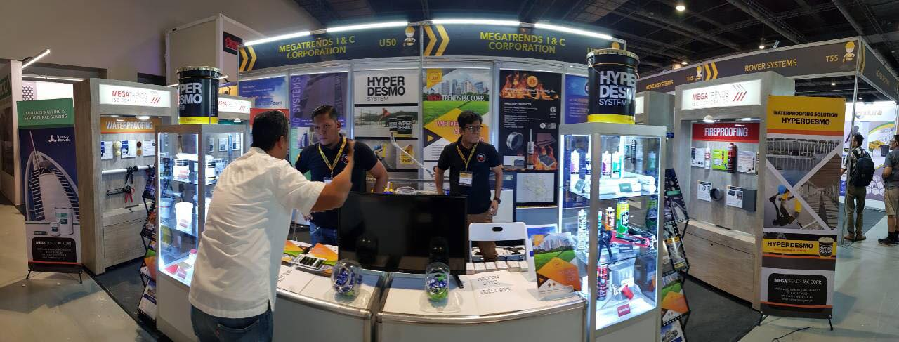
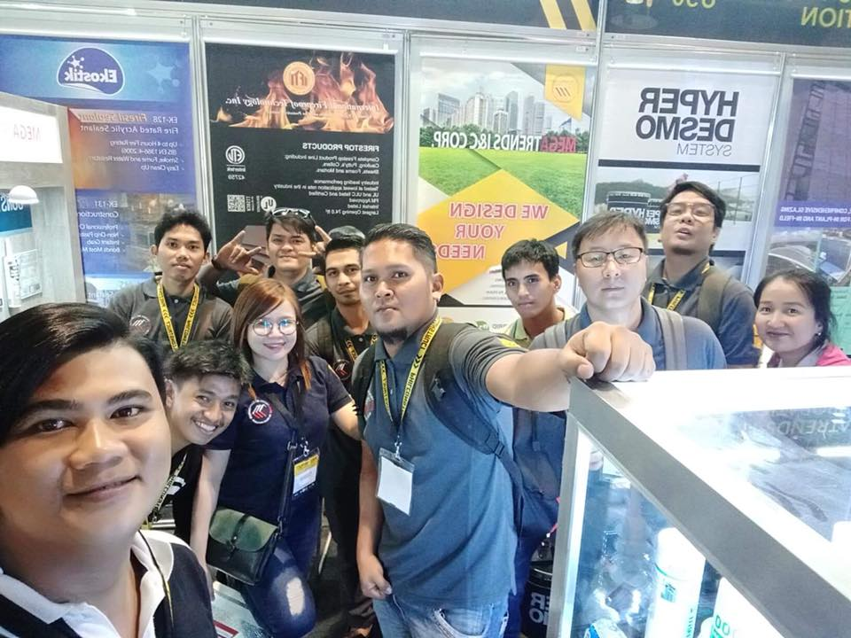
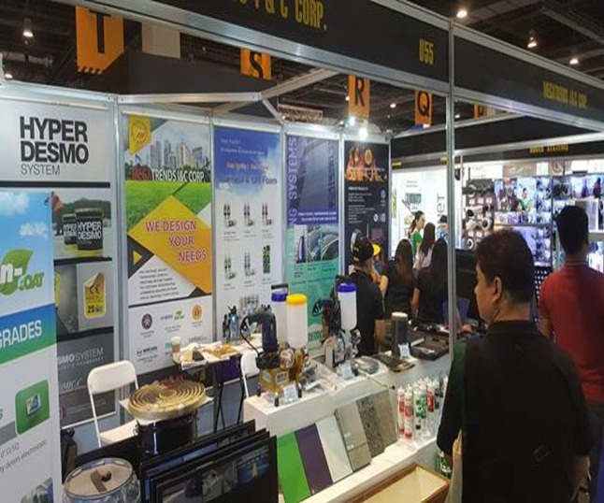
MCSI
MEGATRENDS CHEMICAL SOLUTION INC
2. Trade Shows
Megatrends actively participates in two of the major construction Trade Show in the Philippines since 2008.
Worldbex – Held every March
Philconstruct - Held every November

Slide 7

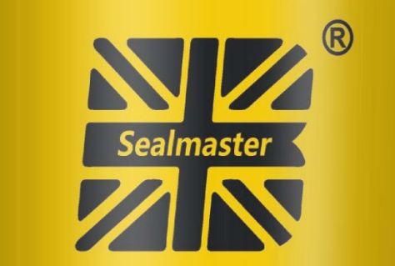
MCSI
STRUCTURAL & GENERAL
GLAZING PRODUCTS
Structural
&
General Glazing

Slide 8
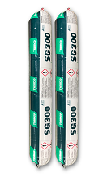
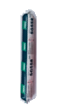
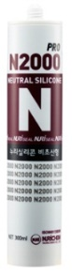
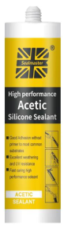
MCSI
STRUCTURAL & GENERAL
GLAZING PRODUCTS
STRUCTURAL SILICONE GLAZING
TREMCO SG300 - STRUCTURAL SILICONE SEALANT
SG300 is a versatile, high performance silicone sealant which reacts with atmospheric moisture to produce a flexible silicone rubber, ideal for a wide variety of joint sealing and structural glazing application.
TREMCO SG558 WEATHER SILICONE SEALANT +/- 50%
SG558 is a one component sealant in applications where a high degree of joint movement is anticipated such as in structurally glazed curtainwall or aluminum cladding. It can also be used as d premium grade sealant in general applications such as expansion joints and external perimeter joints.
GENERAL SILICONE GLAZING
NEUTRAL CURE GENERAL PURPOSE SILICONE SEALANTS
Neutral silicone sealant N2000Pro is specially designed for a wide range of sealing application, which is oxime cure type on commonly used material in windows perimeter and ACP.
General glazing in glass, fiberglass, plastic and Aluminum
Sealing and joint application for sandwich panel installation
GI sheet , Roofing
+/- 30% Movement
ACETIC CURE GENERAL PURPOSE SILICONE SEALANTS
Sealmaster is a premium grade of one component, ready to use acetic curing silicone sealant for general purpose sealing applications (interior and exterior both). It has excellent adhesion, weatherbility, Elasticity and primer-less adhesion to most substrates.

Slide 9

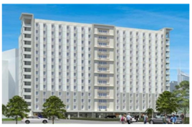
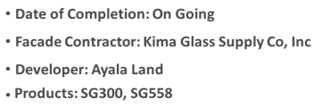
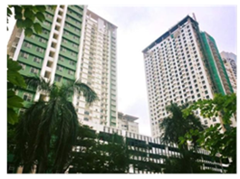
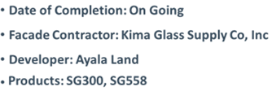
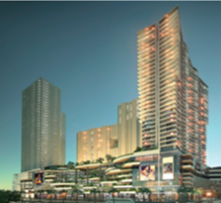
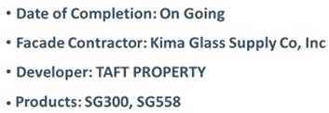
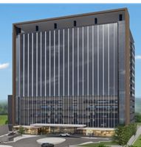
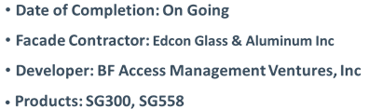
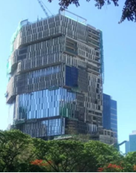
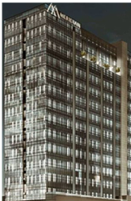
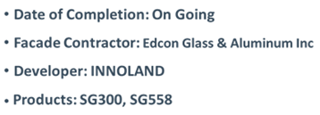
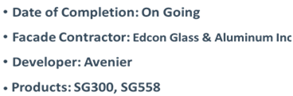
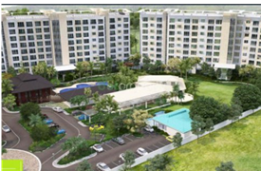

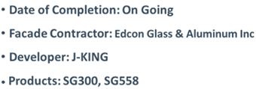
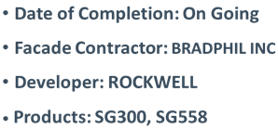
MCSI
STRUCTURAL & GENERAL
GLAZING PRODUCTS

Slide 10

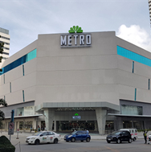
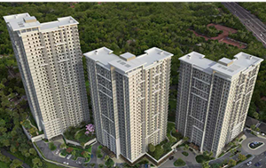
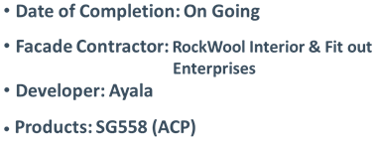
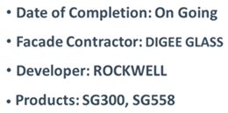
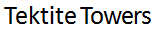
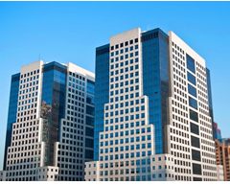
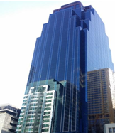
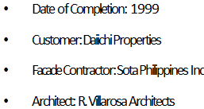
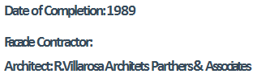
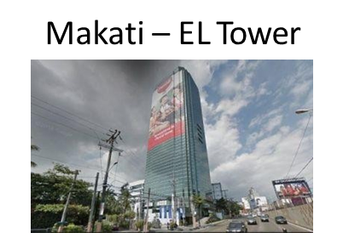
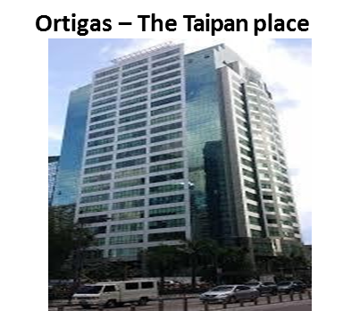






MCSI
MEGATRENDS CHEMICAL SOLUTION INC

Slide 11




MCSI
WATERPROOFINGS
Waterproofing
Solution

Slide 12



MCSI
WATERPROOFING - POLYURETHANE
WATER BASE EPOXY PRIMER
SOLVENT BASE PU PRIMER
(DECKSEAL UP-100)

Slide 13




MCSI
WATERPROOFING - POLYURETHANE
NON-EXPOSED BASE COAT
NON-EXPOSED BASE COAT

Slide 14




MCSI
WATERPROOFING - POLYURETHANE
EXPOSED BASECOAT
EXPOSED BASECOAT FOR WATERTANK
EXPOSED PU TOP COAT

Slide 15











MCSI
WATERPROOFING - POLYURETHANE

Slide 16




MCSI
WATERPROOFING
CEMENTITIOUS & CRYSTALIZATION
FLEXIBLE CEMENTITIOUS
CONTITE FLEX
A 2 part polymer modified flexible cementitious waterproofing membrane for the protection of concrete & mortar.
Suitable for many waterproofing applications including for wet areas, pools, basements, balconies, reservoirs, tunnels etc.
CONTITE WS2
A semi flexible two part polymer modified cementitious water-proofing membrane for concrete & mortar.
Waterproofing slurry for reservoirs, basements, pools, water tanks, plants etc.
CRYSTALLIZATION
CONTITE SEAL
A unique chemical treatment for concrete corrosion protection and waterproofing by crystallization.
Corrosion protection and waterproofing of concrete tunnels, reservoirs, water tanks, waste water tanks, manholes, pipes and basements etc. No curing required.
WATER PLUG
CONTITE PLUG
A fast setting permanent water-plug. Ready to use mixed with water it becomes a powerful water-plug to stop pressure leaks.
Uses include to stop pressure and seepage leaks through concrete and rocks in: joints, culverts, basements, tunnels, dams, pools, subways etc.

Slide 17





MCSI
WATERPROOFING
TORCH MEMBRANE & BENTINITE WATERSTOP
VANDEX SUPER
A cementitious, ready-mixed, in-depth waterproofer. VANDEX SUPER is based on grey Portland cement.
Crystalline waterproofing
• in-depth waterproofing and protection slurry
• permanent active
• applied to pressure or non-pressure concrete face
• approved for drinking water structures
• grey
TORCH MEMBRANE (3MM & 4.5KG)
BITUNIL - NILOBIT
ODE – OPAL OP 400
Elastomeric waterproofing membranes manufactured in an advanced continuous calendaring process by saturating and coating a synthetic carrier with a waterproofing compound which is modified with APP modified Bitumen Polymers.
HYDROPHILIC BENTONITE WATERSTOP (HYPERSEAL DB2519)
HYPERSEAL DB2519
A flexible butyl rubber and swellable clay waterproofing compound that swells upon contact with water to form a long-lasting compression seal in non-moving concrete joints. HYPER STOP is used primarily for foundation walls slabs, slabs-on-grade, precast wall panels, manholes, pipe connections, box culverts, utility and burial vaults, wet wells, and potable water tanks.

Slide 18







MCSI
WATERPROOFING
PU & EPOXY INJECTION
CRACKSEAL SW-PU200 is a single component moisture curing polyurethane expandable injection foam ideally suitable for water cut-off in wet dynamic cracks and joints. It is designed for concrete crack and joint waterproofing applications as commonly found in most concrete and masonry structures such as parking garages, basements, elevator shafts, pools and planters,
CRACKSEAL SW-pu900 is a low viscosity, two components, hydrophobic MDI polyurethane based resin on a MDI polyurethane. The product is 100% solids and solvent free. This high grade injection resin in designed for application in damp and dry cracks, unlike water activated products. It dose not need an moisture for the reaction.
MEGACONFIX LV is a two component adhesive system composed 100% solid epoxy that contains polyamide curing agent designed for the all around remedy of structural concrete defects and flaws particularly the repair of cracks by pressure injection. Aside from sealing cracks and crevices and filling voids, it can also be combined with fine aggregates or silica sand to result in an Epoxy Mortar for high strength grouting.

Slide 19









MCSI
MEGATRENDS CHEMICAL SOLUTION INC
MACTAN NEW TOWN

Slide 20










MCSI
MEGATRENDS CHEMICAL SOLUTION INC

Slide 21












MCSI
MEGATRENDS CHEMICAL SOLUTION INC

Slide 22


MCSI
FIRESTOPS
Firestop
Solution

Slide 23





MCSI
FIRESTOPS

Slide 24




MCSI
MEGATRENDS CHEMICAL SOLUTION INC

Slide 25


MCSI
FIRESTOPS
DYMONIC 100
PRODUCT DESCRIPTION
Dymonic® 100 is a single-component, medium-modulus, non-sag polyurethane sealant. Dymonic 100 offers a high-performance, high movement, durable, flexible seal that performs excellently in moving joints and exhibits tenacious adhesion to substrates once fully cured.
ASTM C920 Type S, Grade NS, Use NT,T,M,A,O,I
U.S.Federal Specs TT-S-00230C, Class A, Type II
CAN/CGSB-19,13-M87
Intn’l Code Council(ICC) Sect R703.8 Flashing
AAMA 714-15
NFPA(National Fire Protection Association) 285 listed Component
ASTM E-1966 (UL 2079)
TREMSTOP® ACRYLIC
PRODUCT DESCRIPTION
TREMstop® Acrylic is a gunnable, acrylic latex sealant designed for use in firestopping applications, including both joints and through penetrations.
UL 1479 (ASTM E814) •
UL 263 (ASTM E119) •
UL 723 (ASTM E84) •
UL 2079 (ASTM E1966) •
ASTM E1399 •
ASTM E90 •
CAN/ULC-S115 •
CAN/ULC-S101

Slide 26









MCSI
FIRESTOPS

Slide 27








MCSI
FIRESTOPS

Slide 28




MCSI
CONSTRUCTION ADHESIVES & JOINT SEALANT
Construction Adhesive
&
Joint Sealants

Slide 29




MCSI
CONSTRUCTION ADHESIVES & JOINT SEALANTS
MEGAFLEX PU25 - PU SEALANT
MEGAFLEX PU25 is a one-component, gun-grade, non-sag polyurethane low modulus construction sealant, it cures under the influence of atmospheric moisture to form a permanently elastic sealant with excellent adhesive properties and resistance to ageing and weathering.
Good adhesion on all typical construction materials
EK-140S – MS SEALANT
EK-140S is A single component , moisture cured elastomeric hybrid sealant based on advanced MS(Modified silicone) polymer technology. Superior UV resistance, Zero VOC, Non staining ,Paintable
No Silicone oil , No isocyanate , No solvent
TIGER FOAM – PU FOAM
Tiger Foam (G) is a Gun type, a polyurethane-based fast curing expanding foam for filling gaps and voids that occur around the home and building construction
Installation of windows and door frames, Insulation of pipes, sealing precast joints.etc
BCR 470 EPOXY21 – CHEMICIAL ANCHOR
MEPF Applications:
Fixing Machines, Cooling, Fixing genset, Aircon
compressor, Water tanks, Air dumper, Raised flooring
Glass & Alum / Façade / Cladding works:
Curtain wall, façade, profile fixing, stone cladding,
Architectural canopy, ACP

Slide 30


MCSI
CONSTRUCTION ADHESIVES & JOINT SEALANTS
ANCOR BOLTS

Slide 31









MCSI
CONSTRUCTION ADHESIVES & JOINT SEALANTS
No More Nail is a one-component construction adhesive formulated to bond on a variety of common construction materials. It has strong initial grab, superior adhesion, and does not slump on vertical surfaces.
One component, heavy duty construction adhesive formulated for general construction, remodeling, maintenance & repair projects. The instant grab formula holds projects in place instantly, reducing bracing requirement. It bonds most construction materials. It has strong initial grab, superior adhesion and will not slump on vertical surfaces.
VT-223 Ultra Flex Gap Sealant is a premium grade high elastic acrylic sealant for both external and internal sealing applications. It is formulated with enhance UV resistant property and can withstand up to 25% movement. It is paintable and formulated for sealing gaps and joints where high movements or vibrations are expected.
VT-286 is a water-based indoor / outdoor air duct sealant for sealing fabricated joints and other types of air ducts. It performs as a tough and flexible adhesive and sealant on the joints and seams, thereby effectively blocks the infiltration of gases, dust and other contaminants and the exfiltration of conditioned air. It is compliant with FDA 21 CFR 177.2600 € & (f)
TL-360 Tiger Lubricant
Lubricating and loosening joints and hinges, removing dirt and residue, and extricating stuck screws and bolts are common usages. The product also may be useful in displacing moisture, as this it its original purpose and design intent.

Slide 32









MCSI
CONSTRUCTION ADHESIVES & JOINT SEALANTS
Studio 7

Slide 33










































MCSI
CUSTOMERS

